Slide 1
Battle of Neighborhoods
Toronto vs New York

Slide 2
Toronto vs New York: Similarities and Differences
Toronto is the provincial capital of Ontario and the most populous city in Canada.
New York is also the most densely populated major city in the United States.
Both the economy is highly diversified with strengths in technology, design, financial services, life sciences, education, arts, fashion, aerospace, environmental innovation, food services, and tourism.
Immigrants, Tourist would be interested to know about the city.

Slide 3
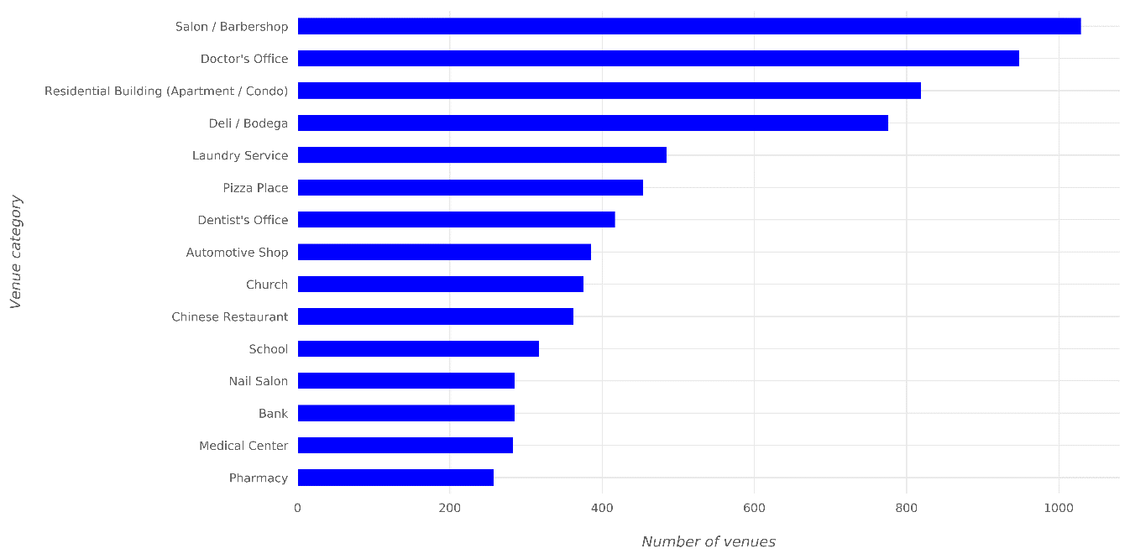
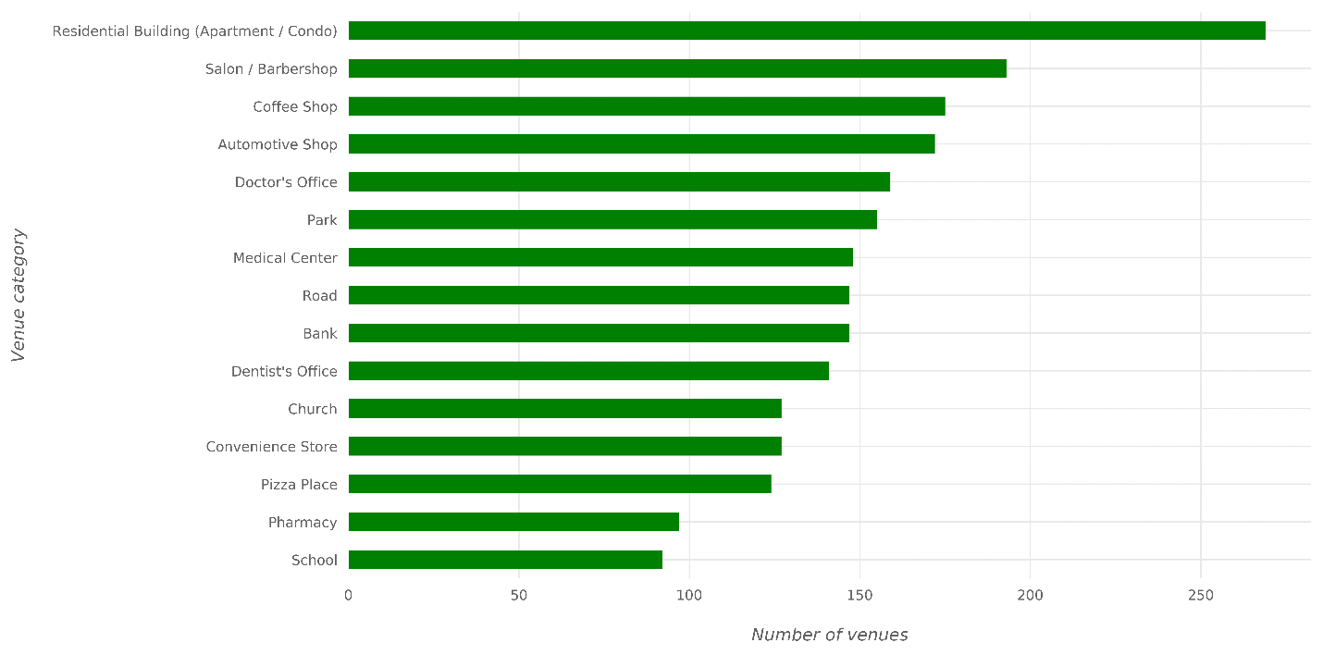
Most Common Venue Categories
New York
Toronto

Slide 4
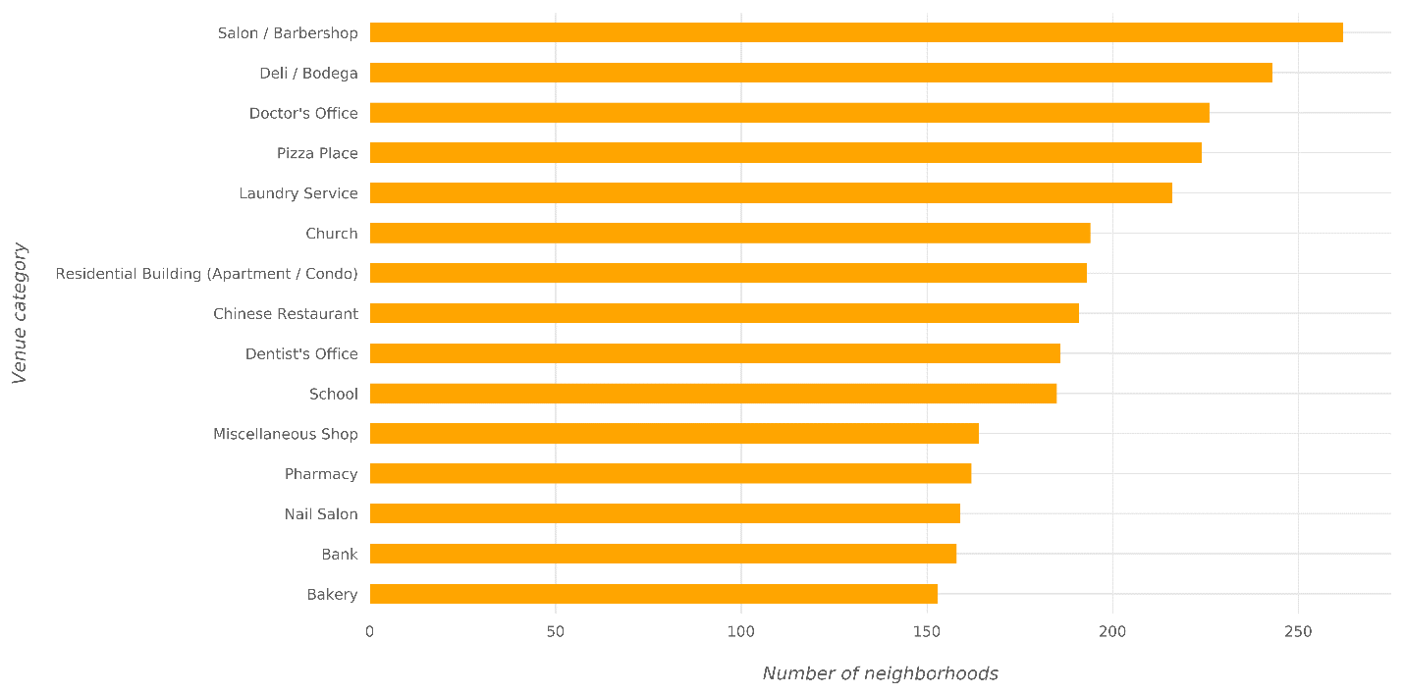
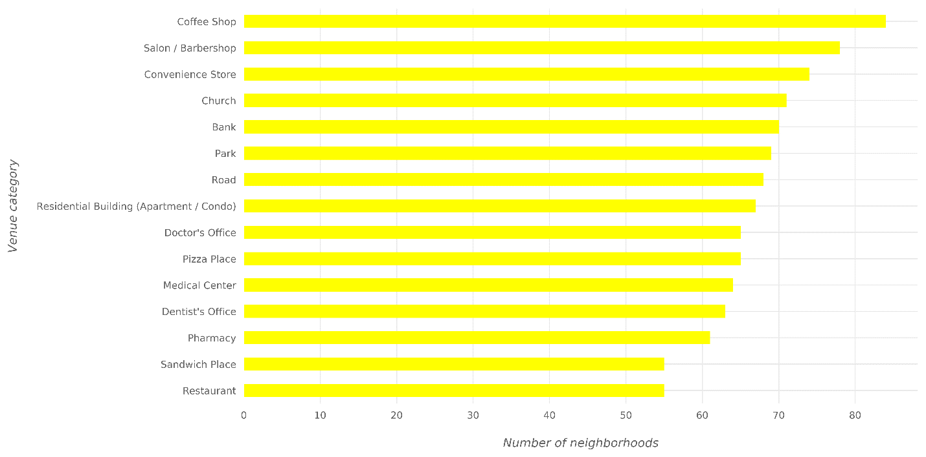
Most Widespread Venue Categories
New York
Toronto

Slide 5
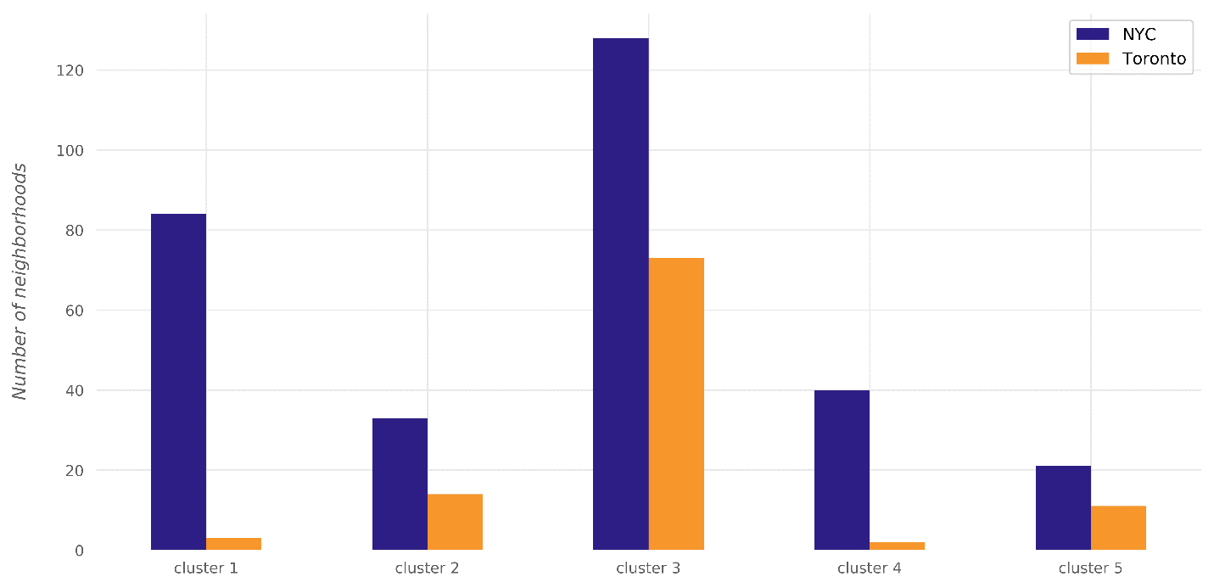
Clustering
Cluster | No. of neighborhoods
1 | 190
2 | 36
3 | 45
4 | 86
5 | 48

Slide 6
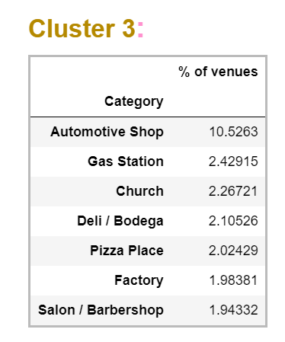
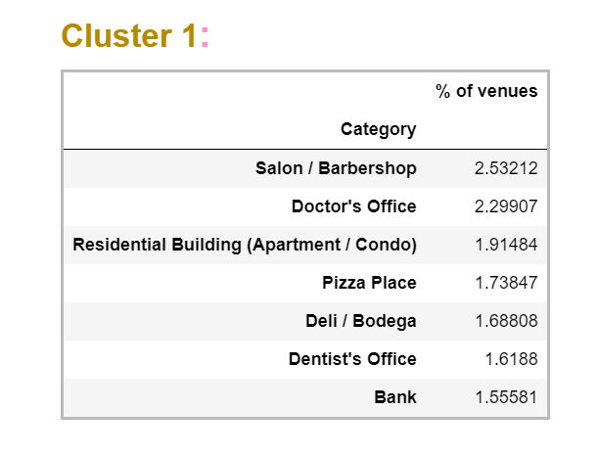
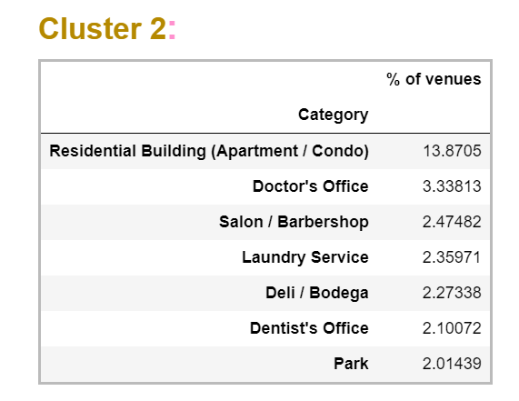
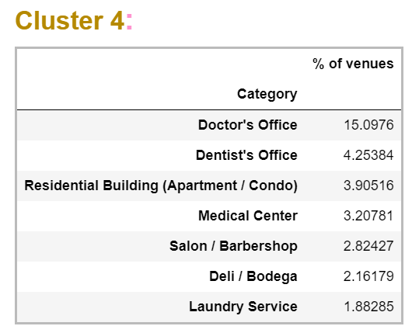
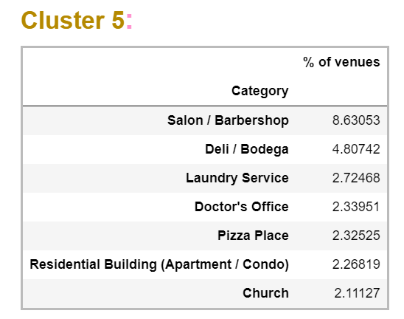
Clustering

Slide 7
Conclusions
While residential buildings constitute ~2% of venues in the neighborhoods of the first cluster, they constitute ~13% of the venues in the second cluster, ~4% of the venues in the fourth cluster, and 2% of the venues in the fifth cluster and completely missing in the third cluster.
Salon/Barbershop appear in the most common category in all the clusters.
Automotive shops appear in the most common category of the third cluster only also the most popular category in that cluster.
Doctor and dentist offices constitute ~15% of fourth-cluster venues while they constitute only 2% to 3% of each of the first, second and fifth-cluster venues.
Other differences can also be observed. If a deeper analysis is performed, it might result in discovering different style in each cluster based on the most common categories in the cluster

